Slide 1
Parallel Computing: A Raspberry Pi Cluster experiment
Damon alcorn
Pete McPherson
Elizabeth wanic

Slide 2
We investigated
How to build a supercomputer
Hardware
Software
What tasks are good/bad for parallelization
How to make parallelization happen on our system

Slide 3
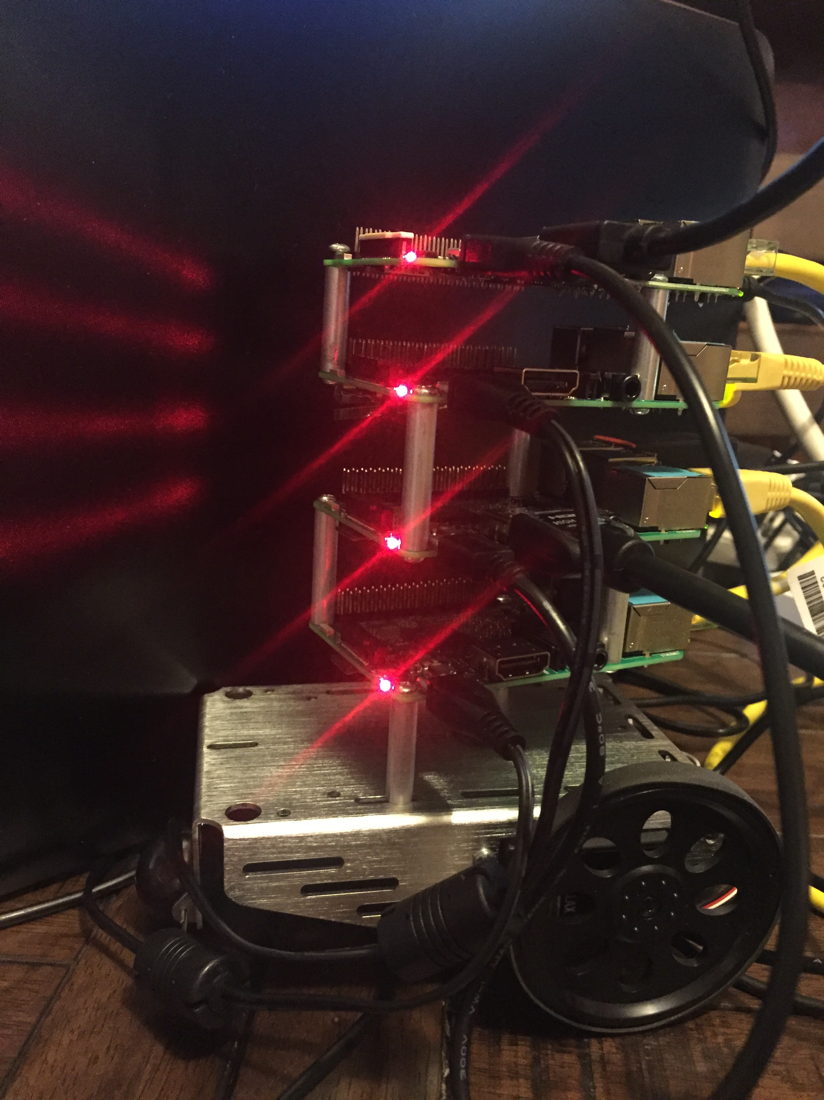
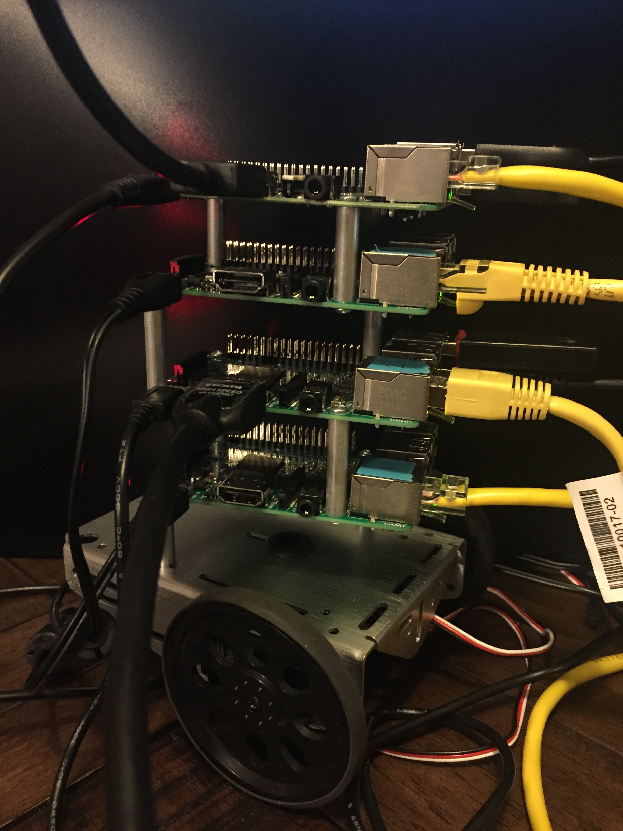
Our Cluster

Slide 4
Set up concerns
Operating System
Configure /etc/hosts with node names and IP addresses
Enable password-less SSH
Install NFS for file sharing
Download MPICH and install dependencies

Slide 5
Experimentation
Brute force password cracking
Compute all possible passwords and hash them
Compare hashes with password file
14, 776, 336 hashes were computed

Slide 6
Results
Running time with one processor was 24 seconds
Two slaves cut this to 12 seconds
Eight slaves cut the time to 2 seconds
Could not get a faster time than 2 seconds, even with use of all 16 processors (1 master, 15 slaves)

Slide 7
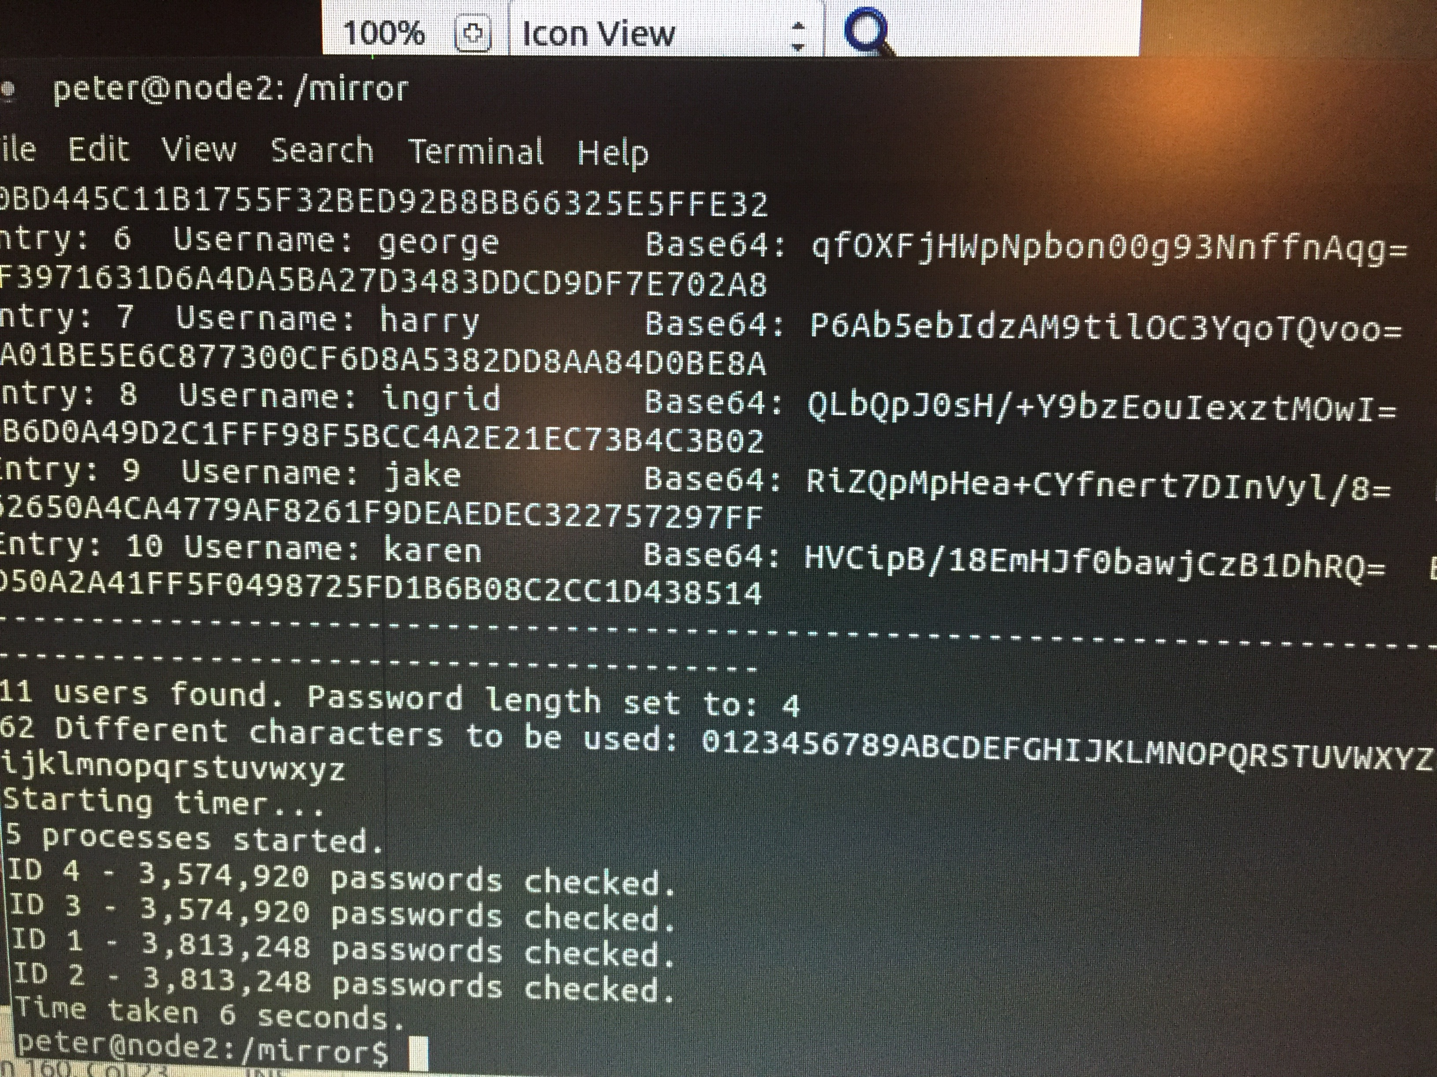
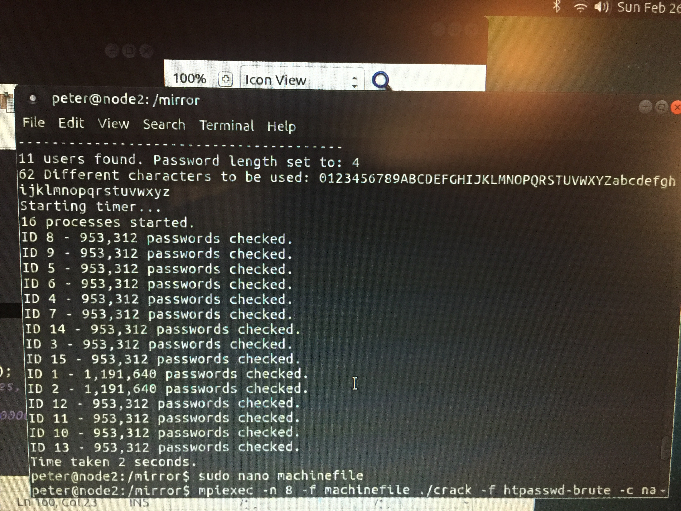
Sample Results

Slide 8
The End

